Slide 1


Spring Boot - Servlet Filter
A filter is an object used to intercept the HTTP requests and responses of your application. By using filter, we can perform below operations under the following situations.
Before sending the request to the controller
Before sending the response to the client
For example, we can use an filter to add the request header before sending the request to the controller and add the response header before sending the response to the client.
Controller
Modified
Request
Request
Servlet Filter
Modified
Response
Response

Slide 2
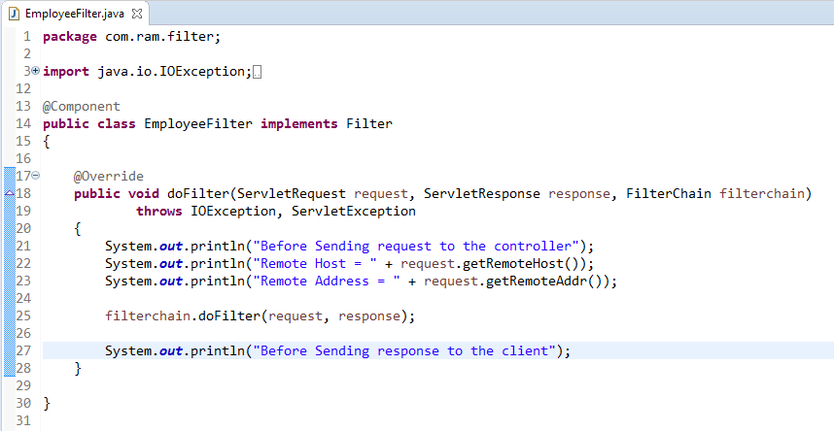
Spring Boot - Servlet Filter

